Slide 1
What is your favorite Programming Language? Feb 2023

Slide 2
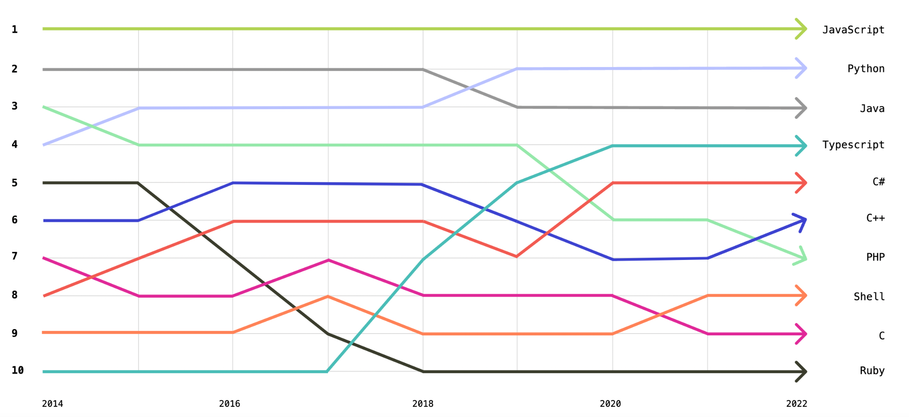
Latest Ranking of Top Languages

Slide 3
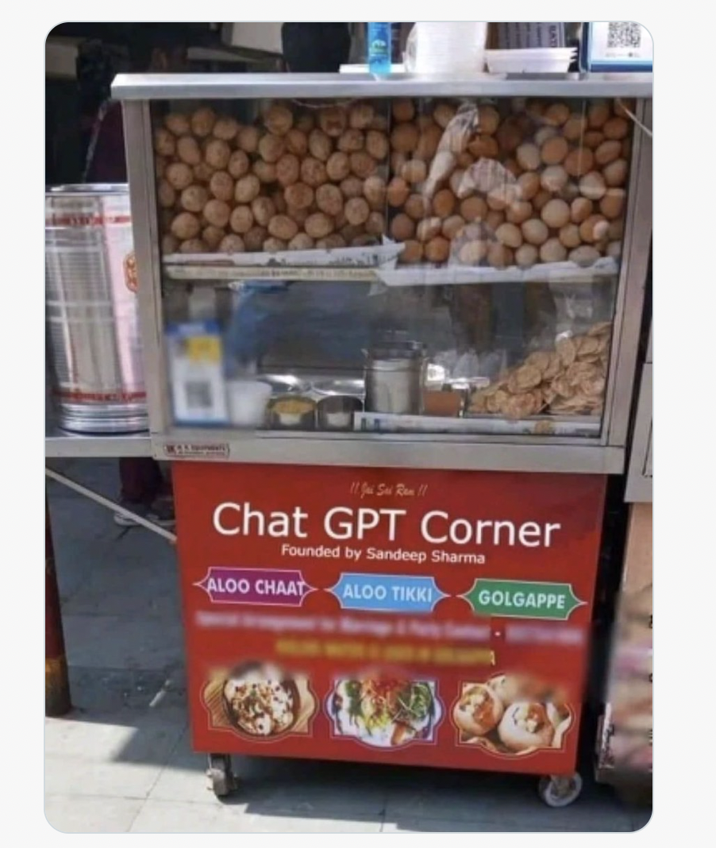
Today’s topic
Gol gappe, Pani puri and Tea
Chaat pe Charcha

Slide 4
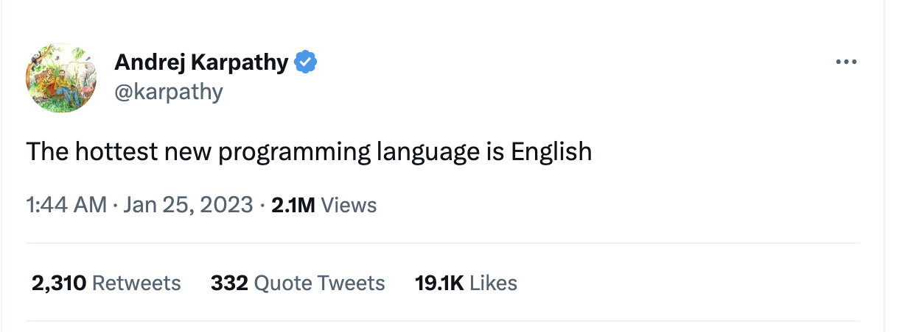
Your favorite programming language soon may be?

Slide 5
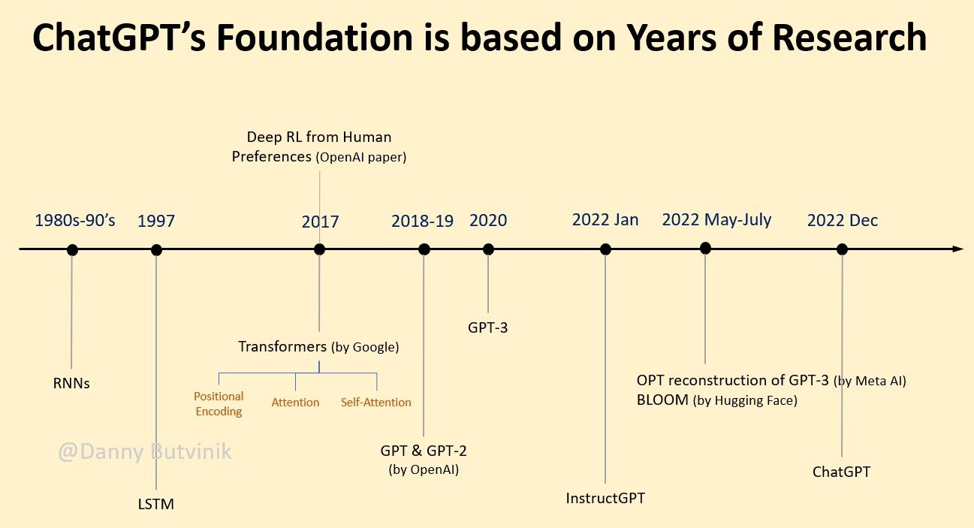
What is ChatGPT?
Generative Pretrained Transformers
Source:https://www.reddit.com/r/learnmachinelearning/comments/116au66/chatgpt_history/

Slide 6
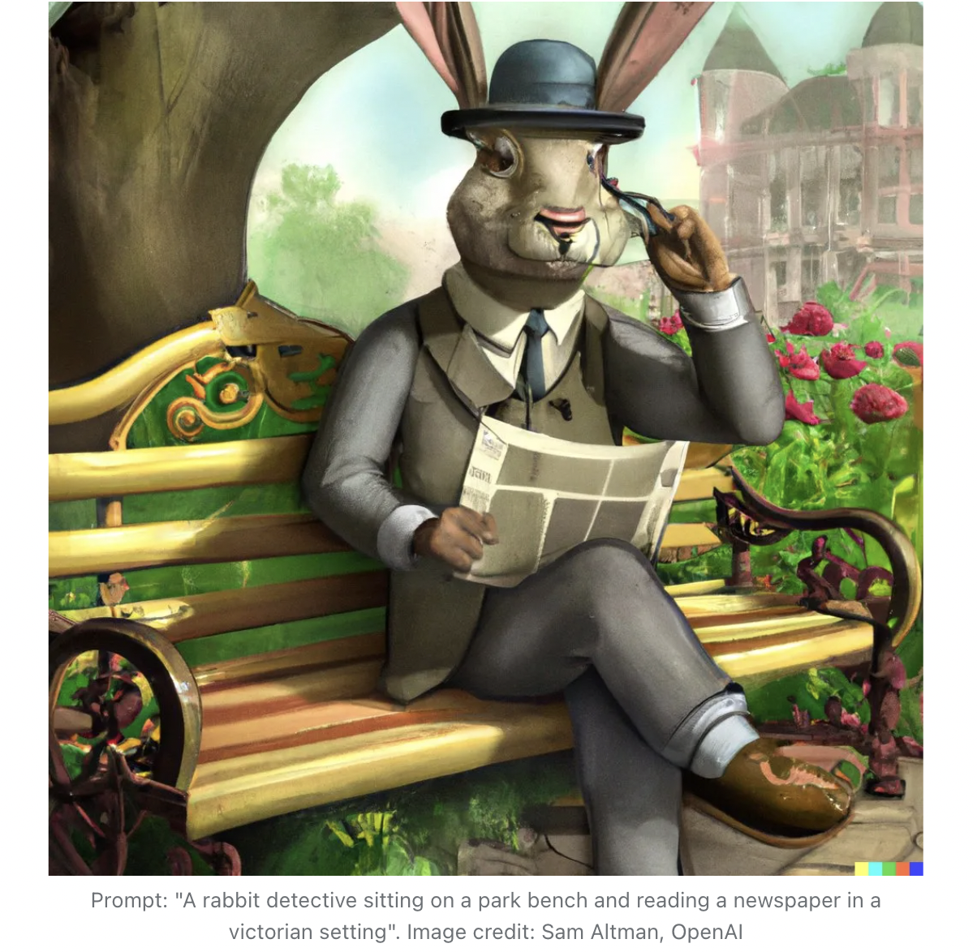
Generative Models
Pre-trained Models
Definition of generative models: Generative models are machine learning models that learn to generate new data that is similar to the training data.
Applications of generative models: Image generation, music generation, text generation, etc.
Visual: Examples of outputs generated by generative models, such as a realistic image of a person, a new piece of music, or a sentence.
Pre-training is a technique where you train a model architecture on a very large dataset. This induces prior knowledge to the model and helps in fine-tuning the model for newer tasks. An example would be training Resnet-50 on ImageNet. (Transfer Learning - eg: YOLO)

Slide 7
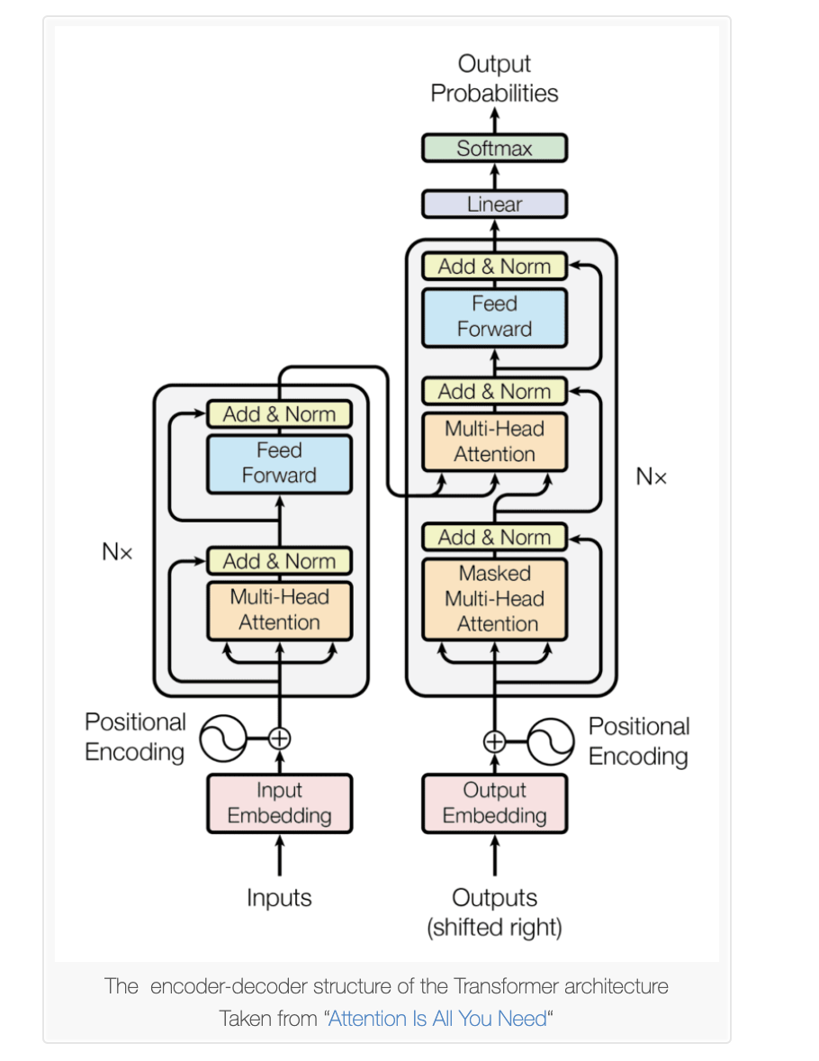
Transformers
Encoder and Decoder block - Understanding and Generation
Intuitive Understanding:
Reading comprehension paragraph and then you have to answer questions or translate.
What was possible earlier: Read in on pass and answer questions:
What transformers enabled: Go back and scan and find section which is relevant and refer to it and answer – “ATTENTION”
https://arxiv.org/abs/1706.03762
Notes:
https://arxiv.org/abs/1706.03762

Slide 8
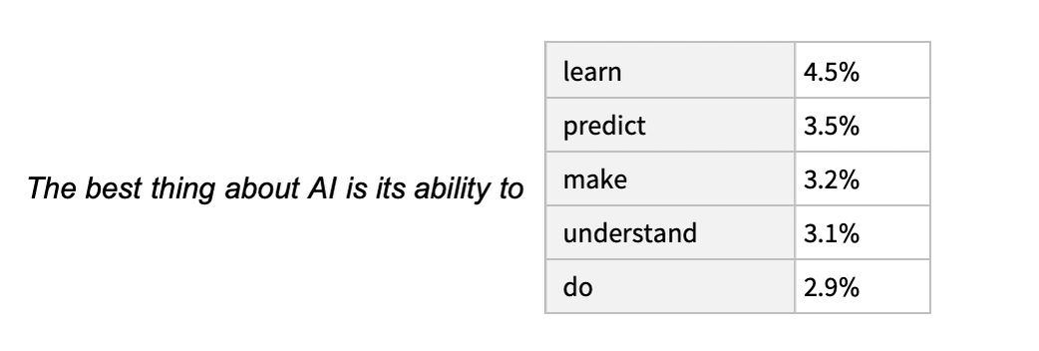
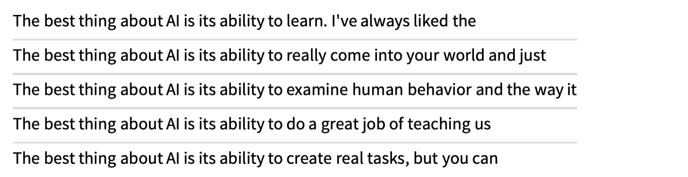
Understanding of Language Models
Self - Supervised
Models
Random sampling for novelty.
Have more parameters like Temperature parameter - for novelty

Slide 9
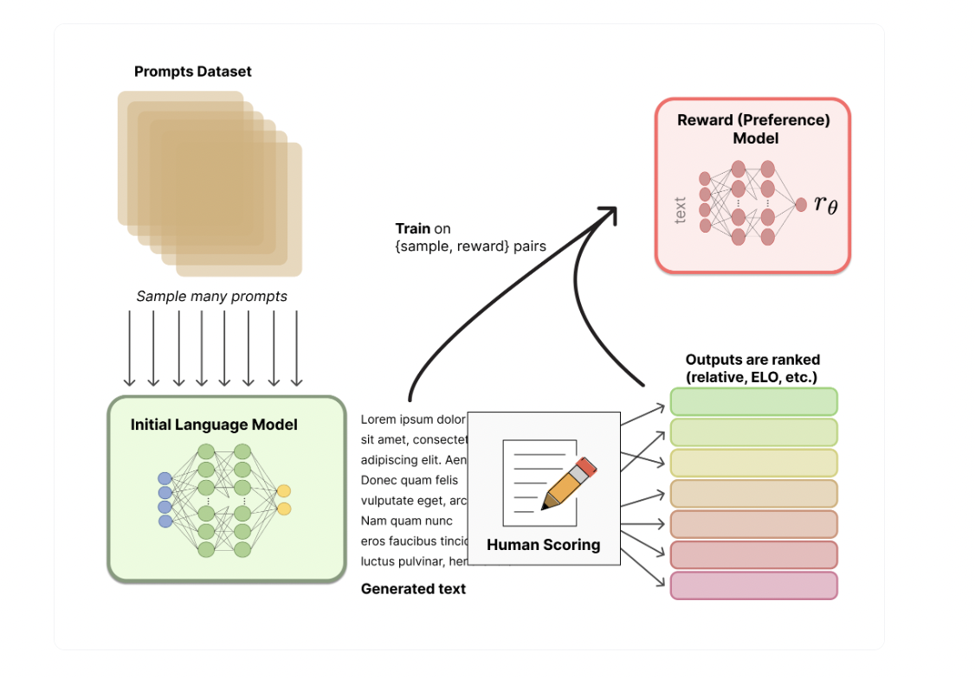
RLHF (Reinforcement Learning with Human Feedback)
Reward Model
Results from LLMs often for long text tend to “wander off” in often rather non-human-like ways.
Reward model for most applications of RLHF (~50k labeled preference samples)
OpenAI got Interns to rank output of LLMs in order of being human like which was used to build reward model
Underlying goal is to get a model or system that takes in a sequence of text, and returns a scalar reward which should numerically represent the human preference
Source: https://huggingface.co/blog/rlhf
Notes:
https://huggingface.co/blog/rlhf

Slide 10
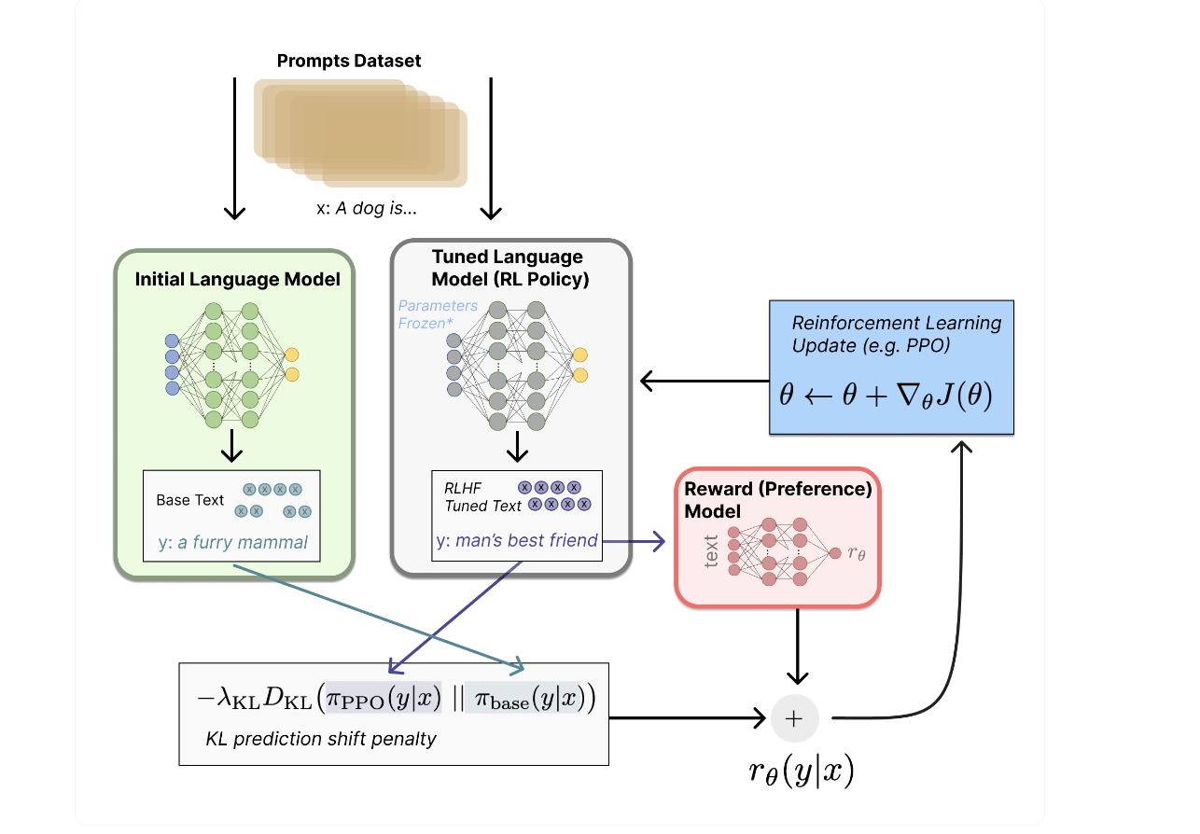
RLHF - Fine Tuning with Reinforcement Learning
What is RL?
Whenever agent interacts with the environment , perform some operation (action) we observe a reaction in the environment and in return we get a reward from the environment.
Source: https://huggingface.co/blog/rlhf

Slide 11
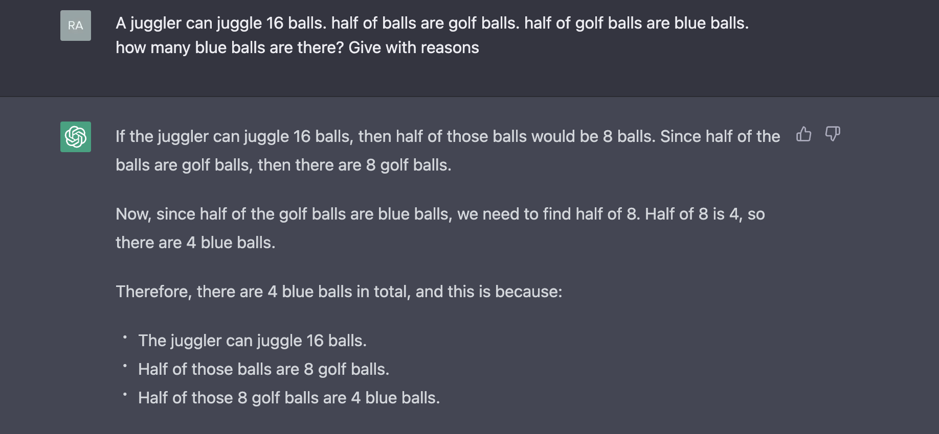
Can it answer logic questions?

Slide 12
Prompt engineering
Prompting is at the heart of working with LLMs.
The prompt provides a context for the text that we want the model to generate.
The prompts we create can be anything from simple instructions to more complex pieces of text, and they are used to encourage the model to produce a specific type of output.
Coming up with a good prompt is a bit of both science and art.
A prompt can have any of the following:
Instructions
Question
Input data
Examples
Source: https://txt.cohere.ai/generative-ai-part-1/

Slide 13
Prompt engineering
Instructions + Question - “How should I write my college admission essay? Give me suggestions about the different sections I should include, what tone I should use, and what expressions I should avoid.
Instructions + Input data
“Given the following information about me, write a 4 paragraph college essay: I am originally from Barcelona, Spain. While my childhood had different traumatic events, such as the death of my father when I was only 6, I still think I had quite a happy childhood.. During my childhood, I changed schools very often, and attended all kinds of schools, from public schools to very religious private ones. One of the most “exotic” things I did during those years is to spend a full school year studying 6th grade in Twin Falls, Idaho, with my extended family.
I started working very early on. My first job, as an English teacher, was at age 13. After that, and throughout my studies, I worked as a teacher, waiter, and even construction worker.”*
Source: https://txt.cohere.ai/generative-ai-part-1/
Notes:
https://amatriain.net/blog/PromptEngineering

Slide 14
Prompt engineering
Question + Examples
“Here are some examples of TV shows I really like: Breaking Bad, Peaky Blinders, The Bear. I did not like Ted Lasso. What other shows do you think I might like?”
Generating prompts at scale
Requires a programmatic approach? – Something like jinja template will emerge soon?
for user,blurb in students.items():
prompt = “Given the following information about {}, write a 4 paragraph college essay: {}”.format(user, blurb)
callGPT(prompt)
Source: https://txt.cohere.ai/generative-ai-part-1/

Slide 15
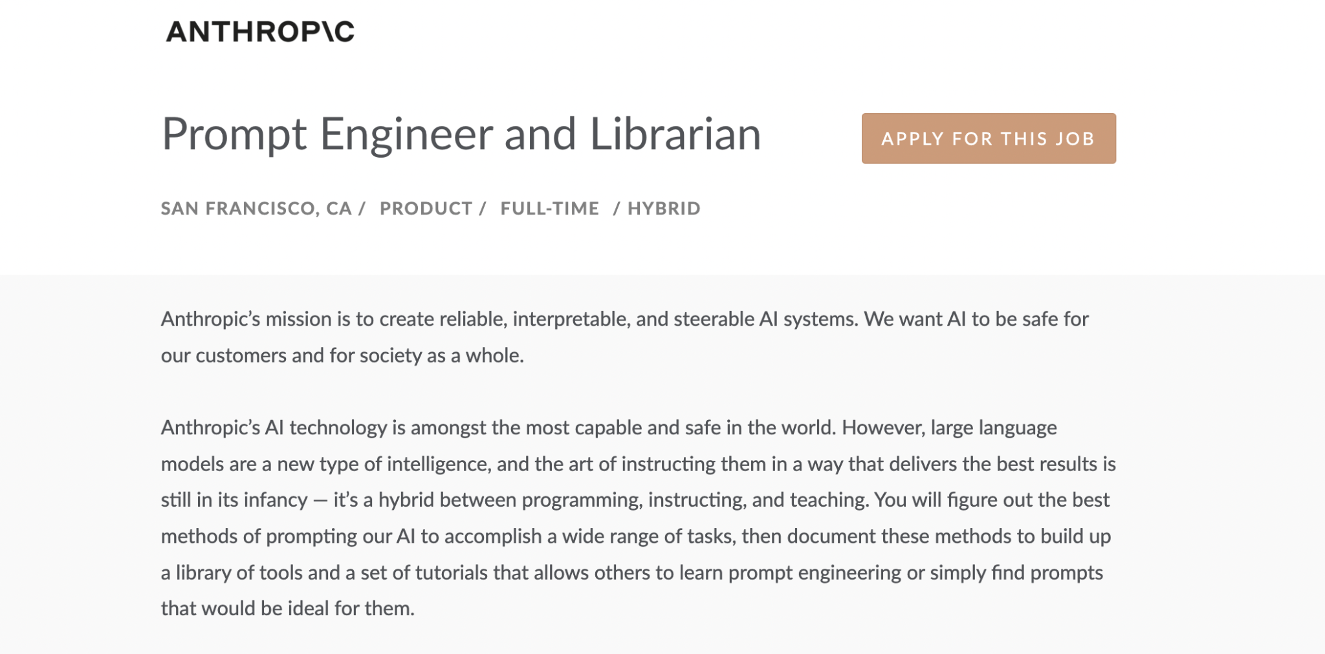
Prompt engineering - New Job Role

Slide 16
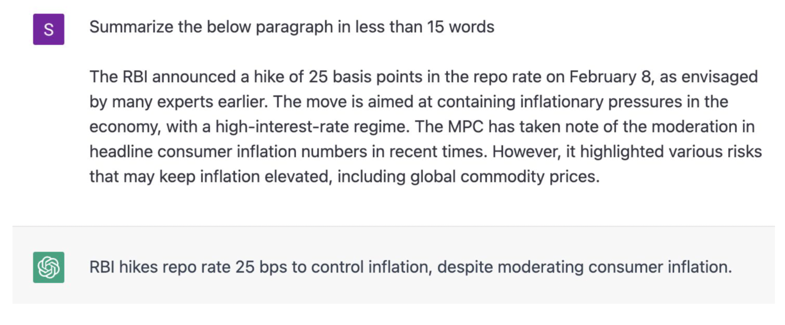
Use Case - Text summarization

Slide 17

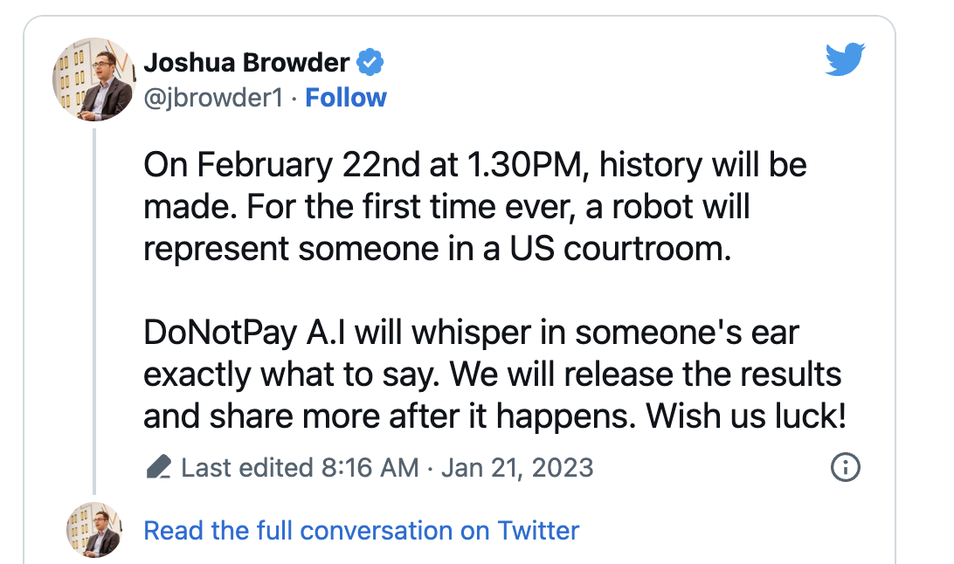
Use Case - You can get your own Mike Ross !!

Slide 18
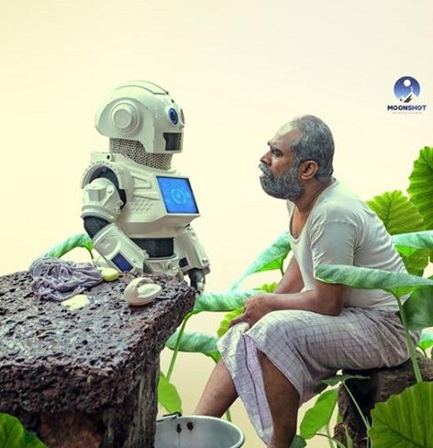
Use Case - Companion for Old Age people

Slide 19
What is in it for us - Programmers?
1. Explaining code
2. Improve existing code
3. Rewriting code using the correct style
4. Simplifying code
5. Writing test cases
6. Exploring alternatives
7. Translating code - Anytime you want to port some code from one language to another
8. Writing documentation
9. Tracking down bugs
10. Scaffolding - kick off the structure of anything new you want to write. GitHub Copilot does a great job at this as well.
Source: https://twitter.com/svpino/status/1611357168200192002
Notes:
https://twitter.com/svpino/status/1611357168200192002

Slide 20
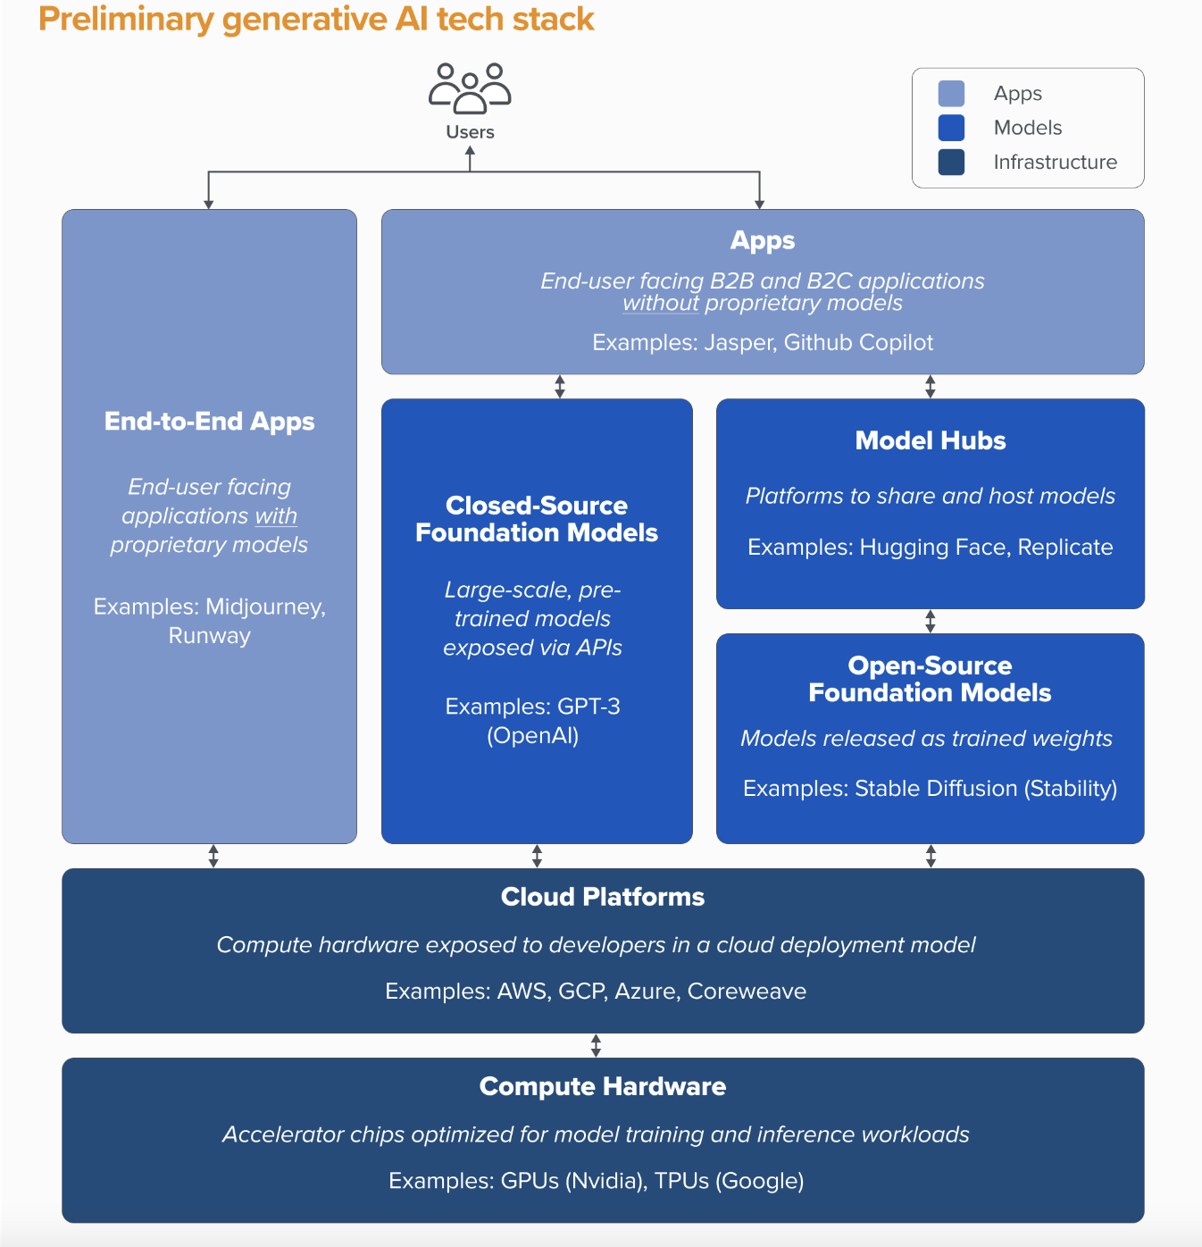
Where is the moat?
The first wave of generative AI apps are starting to reach scale, but struggle with retention and differentiation
Model providers invented generative AI, but haven’t reached large commercial scale
Infrastructure vendors touch everything, and reap the rewards
No systemic moats in generative AI, as of today.
Source:https://a16z.com/2023/01/19/who-owns-the-generative-ai-platform/
Notes:
https://a16z.com/2023/01/19/who-owns-the-generative-ai-platform/

Slide 21
Limitations
Hallucinate
Wrong answers
Does not understand what it’s doing
Potential biases, ethical concerns
Potential to generate fake news
Not being able to List Sources
Similar to SQL Injection, Prompting to trick LLM to do something undesirable
CHATGPT IS BLURRY JPEG OF THE WEB
Source: https://www.newyorker.com/tech/annals-of-technology/chatgpt-is-a-blurry-jpeg-of-the-web
Notes:
https://www.newyorker.com/tech/annals-of-technology/chatgpt-is-a-blurry-jpeg-of-the-web
Now, losing your Internet access isn’t quite so terrible; you’ve got all the information on the Web stored on your server. The only catch is that, because the text has been so highly compressed, you can’t look for information by searching for an exact quote; you’ll never get an exact match, because the words aren’t what’s being stored. To solve this problem, you create an interface that accepts queries in the form of questions and responds with answers that convey the gist of what you have on your server.
What I’ve described sounds a lot like ChatGPT, or most any other large language model. Think of ChatGPT as a blurry jpeg of all the text on the Web. It retains much of the information on the Web, in the same way that a jpeg retains much of the information of a higher-resolution image, but, if you’re looking for an exact sequence of bits, you won’t find it; all you will ever get is an approximation. But, because the approximation is presented in the form of grammatical text, which ChatGPT excels at creating, it’s usually acceptable. You’re still looking at a blurry jpeg, but the blurriness occurs in a way that doesn’t make the picture as a whole look less sharp.

Slide 22
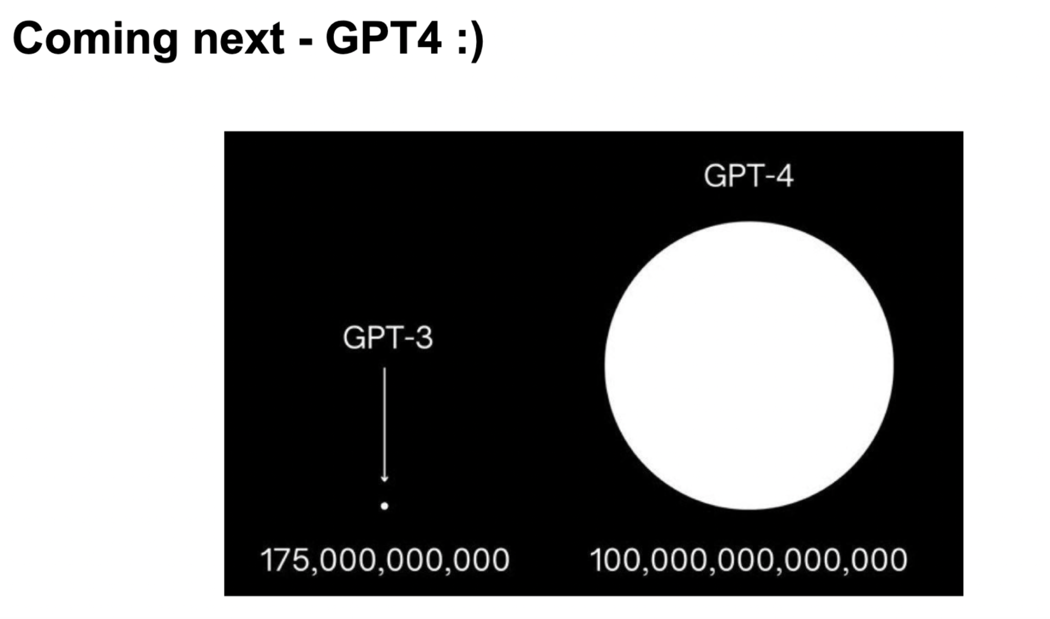
What next?
Bigger Size - better response
Include latest information
Multi-modal models - text, image and videos together
You can give script and create your own short videos

